Slide 1
Digital Pulse Oximeter
Yifei Du Tianyang Hu Team 8

Slide 2
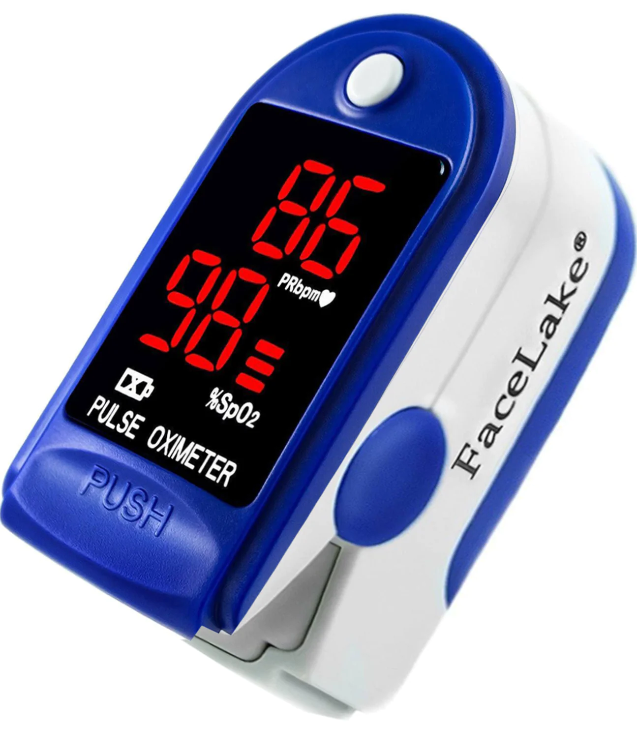
Introduction
Primary Function: Monitoring Blood Oxygen Saturation Level (SpO2)
Importance: Early detection of Hypoxemia.
Advantages:
Non-invasive
Portability
Notes:
Function
A primary function of pulse oximeters is measuring the blood's oxygen saturation level (SpO2). This is vital for monitoring patients with conditions affecting their blood oxygen levels, such as asthma, pneumonia, and COVID-19. Pulse oximeters can detect hypoxemia (low blood oxygen levels) before it becomes dangerous. This early detection is crucial, especially in emergencies, such as monitoring patients with respiratory or cardiovascular conditions. Beyond clinical settings, pulse oximeters are used in fitness and wellness contexts, such as by athletes training at high altitudes or in other specialized conditions to ensure safe and effective training regimes.
Advantage
Non-invasive Monitoring: They provide a non-invasive way to monitor the oxygenation of a patient's hemoglobin. Usually, a sensor is placed on a part with a thin skin layer of the patient's body, such as a fingertip.
Portability and Accessibility: Modern digital pulse oximeters are small, portable, and easy to use, making them accessible not only in hospitals but also in community clinics, ambulances, and home care settings.

Slide 3
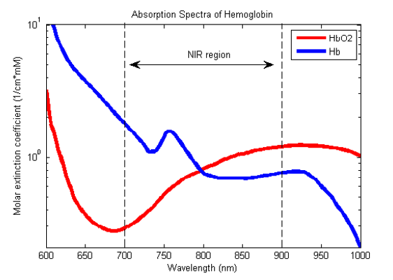


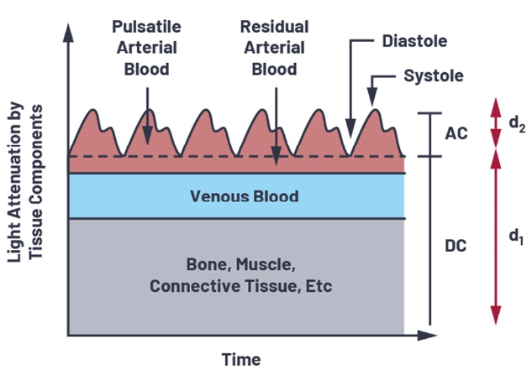


Principle of Operations
SpO2 is defined as the fraction of oxygenated hemoglobin within all hemoglobin.
Compartment Model and Beer’s Law enable the non-invasive Pulse Oximetry
Light Intensity (I) is measured at 2 wavelengths (660 nm and 940 nm) and used to obtain SpO2
Notes:
Having explored the important role that digital pulse oximeters play in various scenarios, let's take a look at how our product is engineered.

Slide 4
System Design and Schematic
Finger Clip with Integrated LEDs and Photodiodes
Transimpedance Amplifier
I - Amplified V
Bandpass Active Filter
V - Filtered V
MyRio LabVIEW
Filtered V - SpO2
Finger
LED
Diode
Power (15V, 5V, GND)
Notes:
The schematic of our system is structured as below.
A finger clip with 2 LEDs and photodiodes are attached to patient’s finger. The LEDs are lit up and photodiodes convert incident light

Slide 5


Implementation - Finger Clip
Finger Clip with Integrated LEDs and Photodiodes
Finger
LED
Diode

Slide 6

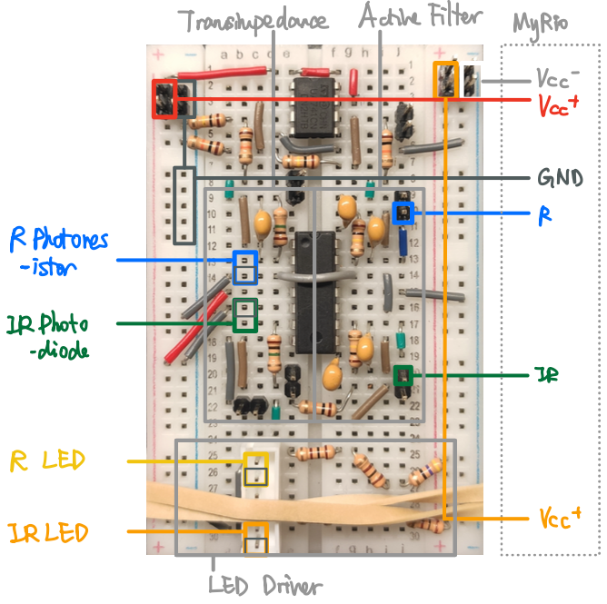
Implementation - Circuits
Transimpedance Amplifier
I - Amplified V
Bandpass Active Filter
V - Filtered V

Slide 7
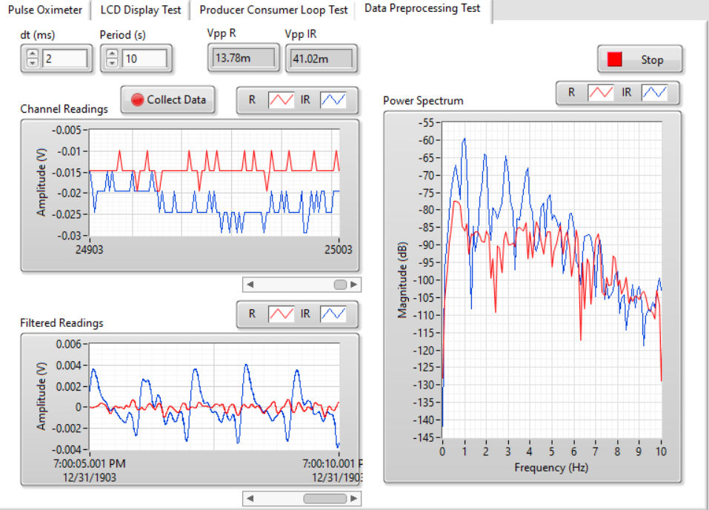
Implementation - LabVIEW
Frequency of Largest Power:
~1 Hz = 60 bpm
Raw Signal
Digitally Filtered Signal
Clear Heartbeat Waveform from IR Channel

Slide 8
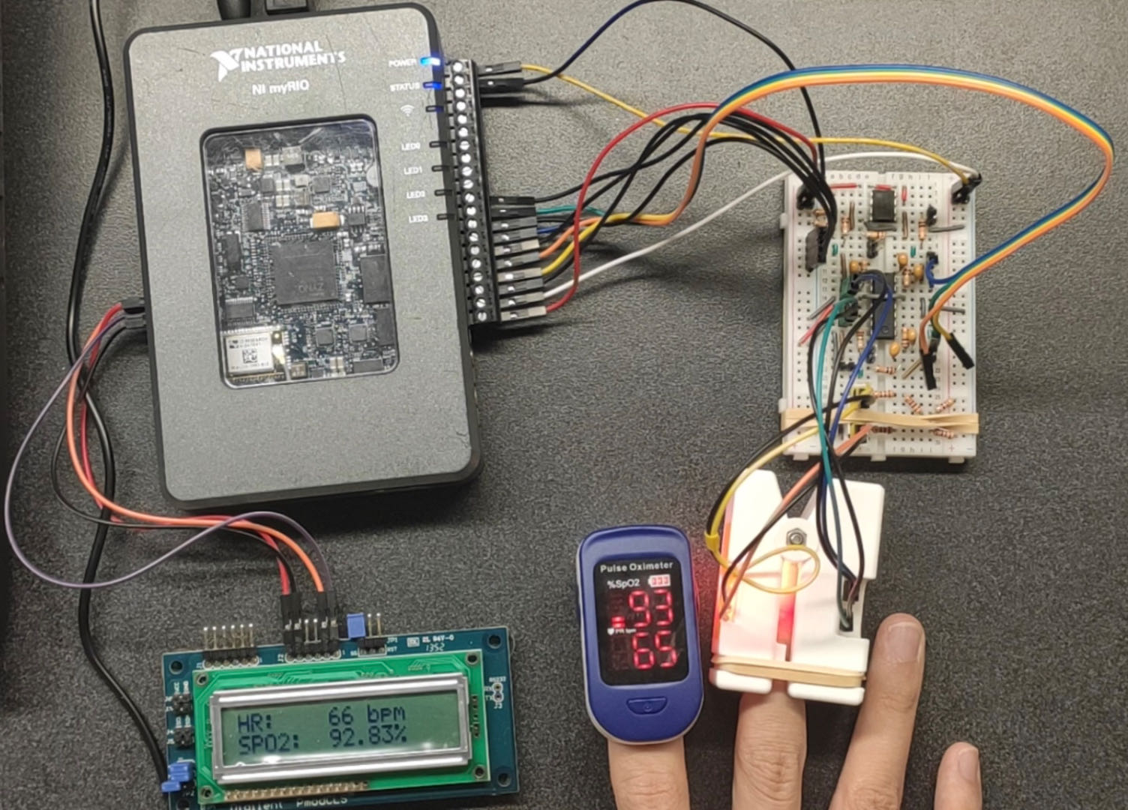
System Overview

Slide 9



Future Improvement
Transmit data remotely
Portable Design
Better signal filtering
Notes:
To make our design function as other commercial products, we need to make the following improvements in the future.
First, we can make our digital pulse oximeters transmit data remotely, aiding in telemedicine and remote patient monitoring, which became particularly important during the COVID-19 pandemic.
Second, we can make the product more portable using integrated circuits rather than bread-board circuits.
Finally, we can modify the circuit or upgrade our electronic parts to get better-filtered signals, which can make the measurements more accurate and stable.

